Slide 1

( GROUP – F )
FRAUD DETECTION ANALYSIS
Presented By:
Komal Sukheja
Syeda Mahrukh
Muhammad Saad Sheikh

Slide 2
OVERVIEW OF DATA SET
The dataset provides a comprehensive collection of financial transaction records, allowing us to examine and understand the occurrences of fraudulent activities. By analyzing this data, we can uncover patterns, anomalies, and trends that indicate potential fraud attempts, ultimately contributing to the development of effective fraud detection methods and strategies..

Slide 3
STAKEHOLDER
Fraud Investigation Manager
We are presenting insights from the fraud detection dataset to the organization's Fraud Investigation Manager, who is tasked with identifying and addressing fraudulent activities. Our goal is to furnish them with actionable information to enhance their detection and investigation procedures.

Slide 4
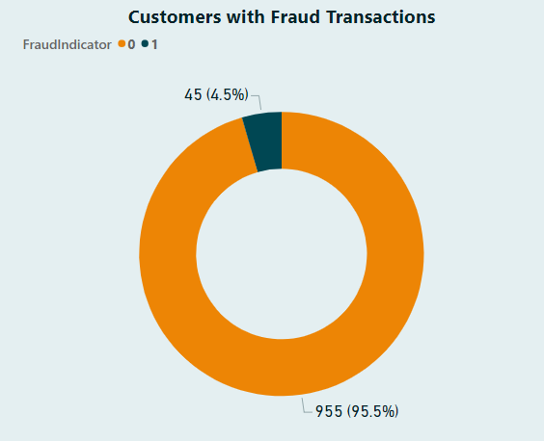
PROBLEM STATEMENT
Develop a robust fraud detection system for the provided dataset, where the current fraud detection rate stands at 4.5%. The objective is to significantly enhance the accuracy of identifying fraudulent transactions while minimizing false positives.

Slide 5
KEY ATTRIBUTES & SIGNIFICANCE
Customers_data: Includes customer profiles with information such as name, age, address, and contact details.
Account_activity: Provides details of customer account activity, including account balance, transaction history, and account status.
Merchant_data: Contains information about merchants involved in transactions.
Transaction_category_labels: Provides category labels for different transaction types.
Transaction_records: Contains transaction records with details such as transaction ID, date, amount, and customer ID.
Transaction_metadata.: Contains additional metadata for each transaction.
Fraud_indicators : Contains indicators of fraudulent patterns and suspicious activities.
Suspicious_activity: Provides specific details of transactions flagged as suspicious.
Amount_data: Includes transaction amounts for each transaction.
Anomaly_scores: Provides anomaly scores for transaction amounts, indicating potential fraudulence.

Slide 6

OBJECTIVES

Slide 7
1. Identify Fraud Patterns:
Analyze the provided data to identify recurring patterns associated with fraudulent transactions.
2. Customer Analysis:
Analyze customers based on their transaction behavior, characteristics, and historical data.
3. Identify correlations:
Cross-reference Fraud indicators with other available data, such as customer profiles and transaction amounts, to identify correlations and build a more comprehensive understanding of potential fraud markers.
4. Age-based Analysis:
Investigating if certain age groups are more susceptible to fraudulent transactions and understanding the factors contributing to this trend.
5. Temporal Trends:
Analyzing transaction patterns over time to uncover seasonal trends that could suggest coordinated fraudulent activities.

Slide 8

RESULTS

Slide 9
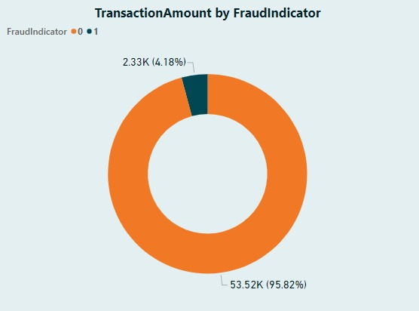
Transaction Amount By Fraud Indicator
Fraudulent transactions makes up about 4.13% of total data set.
The majority of transaction appears to be legitimate which is 95.82%.

Slide 10
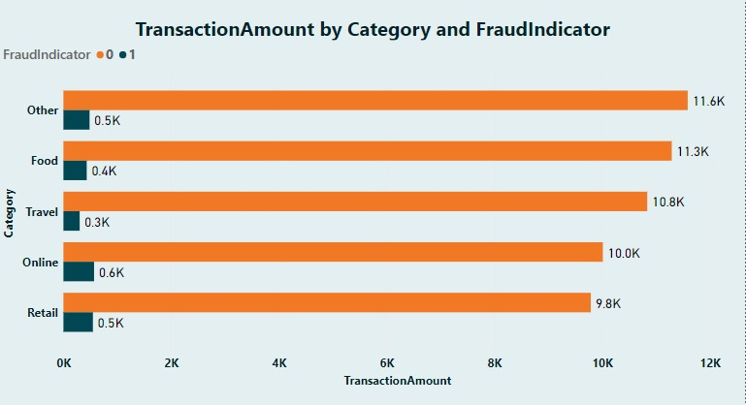
Transaction Amount Analysis
Online and Retail has the highest Fraud transactions
Travel category has the least amount of transactions

Slide 11
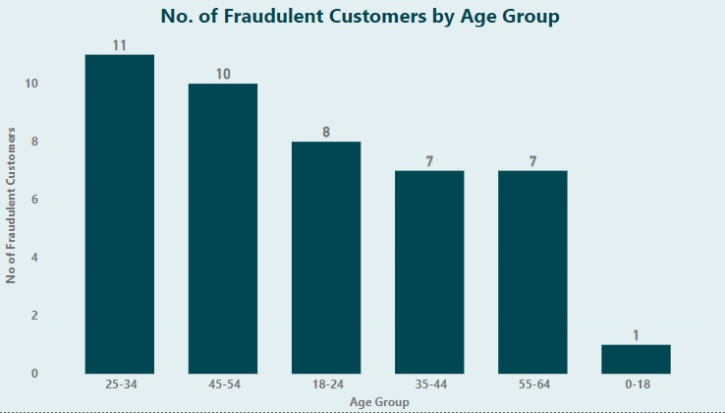
Age Group Analysis
The age group 25-34 are more likely to be involved in fraudulent activities. .
One fraud customer from 0-18 range.

Slide 12
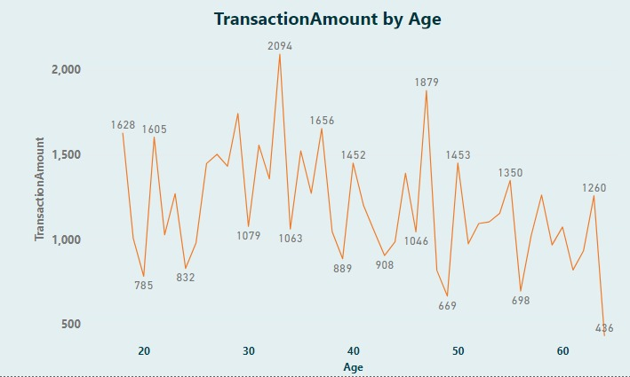
Transaction Behavior Analysis by Age
No significant correlation between a customer's age and the transaction amount.

Slide 13
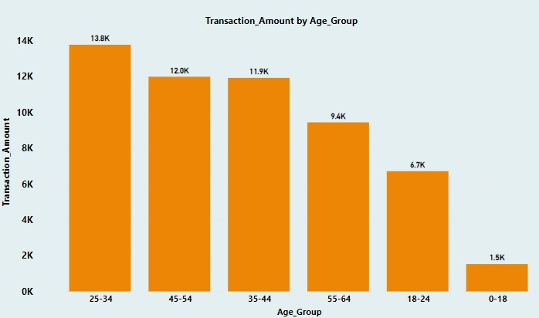
Transaction Behavior Analysis by Age Group
Age Group 25-34 has the highest amount of transactions
Age Group 0-18 has the lowest amount of transactions

Slide 14
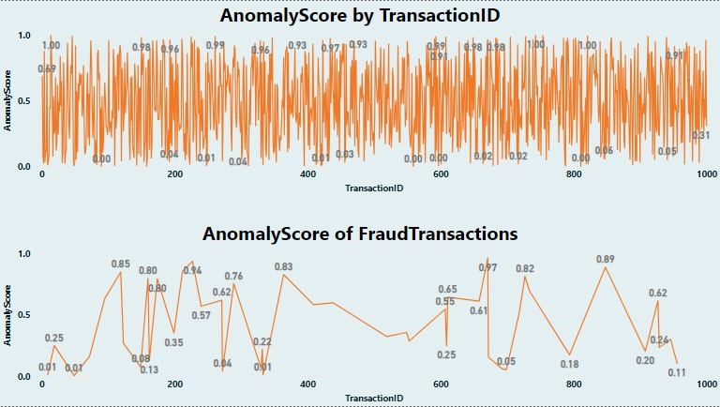
Anomaly scores Analysis
In the dataset, we lack information about the pattern of the anomaly score and how it is calculated.

Slide 15
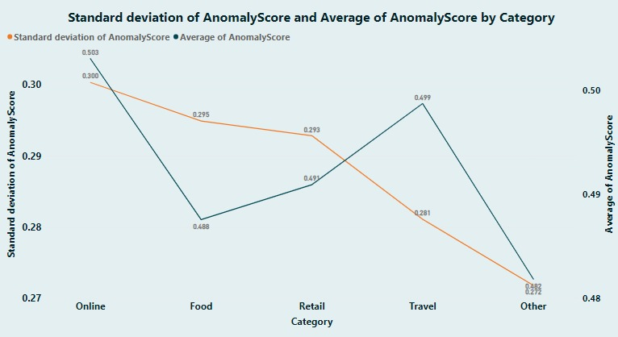
Anomaly scores Analysis
Online and travel categories have the highest average anomaly scores
Online category has the highest standard deviation anomaly scores.

Slide 16
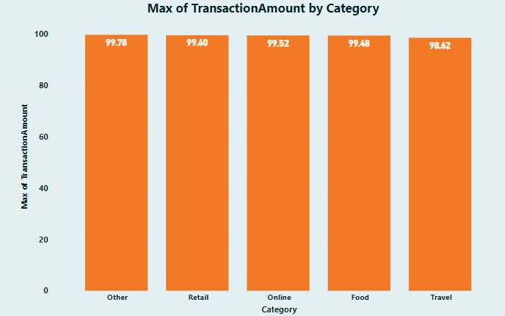
Highest Transaction Amounts
No significant difference between each category.
Retail and Online categories have Highest transaction amount of 99.60 and 99.52
Travel has least 98.62 transaction amount.

Slide 17
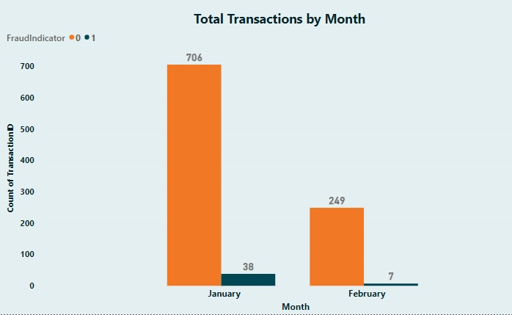
Total Transaction By Month
38 Frauds in January and 7 in February
Having data for only two months might restrict the ability to capture the complete range of fraudulent behaviors and patterns.

Slide 18
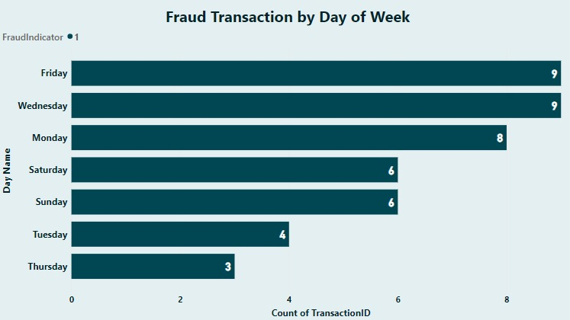
Fraud Transaction by Day
Notable spikes in fraud occurrences are observed on Monday, Wednesday, and Friday, suggesting these days are more susceptible to fraudulent activities.

Slide 19
RECOMMENDATIONS

Slide 20
Transaction Amount By Fraud Indicator Insights
Fraudulent transactions makes up about 4.18% of total data set.
Most of the transactions appear to be legitimate which is 95.82%.
Recommendations:
Refine fraud detection models for efficient management of a smaller percentage of fraudulent transactions, while
Continuously updating them with advanced techniques and expert collaboration to enhance accuracy.

Slide 21
Transaction Amount Analysis Insights
Online and Retail has the highest Fraud transactions
Travel category has the least amount of transactions
Recommendations:
Prioritize high-value categories(online and retail) for effective fraud detection
Enhance methods to uncover potential low-value fraudulent activities, ensuring comprehensive prevention measures.

Slide 22
Age Group Analysis Insights
The age group 25-34 are more likely to be involved in fraudulent activities.
One fraud customer in 0-18.
Recommendations:
Allocate extra resources for monitoring and investigating transactions for 25-34
Implement strict verification for minors.

Slide 23
Transaction Behavior by Age Analysis Insights
No significant correlation between a customer's age and the transaction amount.
Recommendations:
Divide customers into age groups and analyze transaction behavior within each group to
uncover potential insights for targeted fraud detection strategies.

Slide 24
Transaction Behavior Analysis by Age Group Insights
Age Group 25-34 has the highest amount of transactions
Age Group 0-18 has the lowest amount of transactions
Recommendations:
Enhance fraud detection strategies for the highest transaction group (25-34) and consider tailored measures for the other age groups to address their distinct risk profiles

Slide 25
Anomaly scores Analysis Insights
In the dataset, we lack information about the pattern of the anomaly score and how it is calculated.
Recommendations:
Collaborate with experts to gain insight into the contributing factors and
potential algorithmic methods used for calculating the score.

Slide 26
Anomaly Scores By Category Analysis Insights
Online and travel categories have the highest average anomaly scores
Online category has the highest standard deviation anomaly scores.
Recommendations:
Give added focus to anomaly detection in "Online" and "travel" categories to prevent potential fraud
Customize fraud detection models for the "Online" category to ensure accurate identification of transaction behaviors.

Slide 27
Highest Transaction Amounts Analysis Insights
No significant difference between each category.
Retail and Online categories have Highest transaction amount of 99.60 and 99.52
Travel has least 98.52 transaction amount.
Recommendations:
Employ biometric authentication for high-value transactions or sensitive account activities.
Enhance fraud detection by integrating additional features and behaviors beyond transaction amounts, while ensuring thorough attention to all categories to avoid oversights.

Slide 28
Total Transaction By Month Analysis Insights
38 Frauds in January and 7 in February.
Having data for only two months might restrict the ability to capture the complete range of fraudulent behaviors and patterns.
Recommendations:
Continuously update and fine-tune fraud detection models using historical data and feedback loops
Employ expert level techniques that can help to enhance the fraud detection accuracy despite the limited timeframe.

Slide 29
Fraud Transactions By Days Analysis Insights
Notable spikes in fraud occurrences are observed on Monday, Wednesday, and Friday, suggesting these days are more susceptible to fraudulent activities.
Recommendations:
Focus more resources and monitoring efforts on Monday, Wednesday, and Friday to
prevent and quickly respond to potential fraudulent activities.

Slide 30


Slide 31

ANY Queries?

